Slide 1
C++ Programming:
Problem Solving and Programming
Chapter 5
Making Decisions

Slide 2
Objectives
5.1 Selection Control Structure
5.2 Two Way Selection Structure: if-else Statements
  5.2.1 Single-Alternative (Unary) Selection Structure
  5.2.2 Dual-Alternative (Binary) Selection Structure
  5.2.3 Compound Statements
  5.2.4 Conditional Expression (?:)
5.3 Nested if Statements
5.4 Multiple Selection Structure
  5.4.1 else-if Statements
  5.4.2 switch Statements
  5.4.3 Nested switch Statements

Slide 3
Control Structures
Three types of control structure :
Sequence
Selection
Loop
Action
false
true
false
Condition
Condition
Action
true
Action
Action
Action
Action
(a) Sequence
(b) Selection
(c) Loop

Slide 4
One-Way (if) Selection
Syntax:
if (expression)
statement
Action / statement is executed only if the value of the expression is true
No action is executed if the expression is false; program goes to the next statement
Expression
false
true
Action

Slide 5
One-Way (if) Selection - Example
If the student score more than 50 marks or equal to 50 marks, system must shows their result passed.
Pseudocode:
No
score
>= 50
Yes
If score >= 50 then
Print “Passed”
End If
Print
“Passed”
C++ statements:
if (score >= 50)
cout << "Passed";

Slide 6
Two-Way (if…else) Selection
Syntax
if(expression)
statement1
else
statement2
If expression is true, action 1 is executed otherwise action 2 is executed
Expression
false
true
Action 2
Action 1

Slide 7
Two-Way (if…else) Selection
- Example
Many organizations pay employees overtime rate 1.5 times their usual hourly rate if employees work more than 40 hours per month.
Pseudocode:
If hoursWorked >= 40 then
grossPay = hoursWorked * rate * 1.5
Else
grossPay = hoursWorked * rate
End If
false
hoursWorked
>= 40
true
grossPay = hoursWorked * rate
grossPay =
hoursWorked * rate * 1.5
C++ statements:
if (hoursWorked >= 40)
grossPay = hoursWorked * rate *
1.5;
else
grossPay = hoursWorked * rate;

Slide 8
PYQ:
Convert the following algorithm written in pseudocode
into a complete flowchart and program.
Start
Read sales
If sales >= 5000.00 then
Set rate = 0.20
Else
Set rate = 0.10
End If
Set comm = sales * rate
Display comm
End

Slide 9
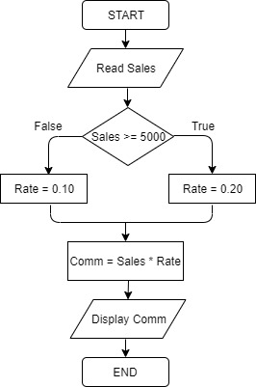
PYQ:
Flowchart:

Slide 10
PYQ:
Program:
#include <iostream>
using namespace std;
void main()
{
double sales, rate, comm;
cout << “Enter sales: ”;
cin >> sales;
if (sales >= 5000.00)
rate = 0.20;
else
rate = 0.10;
comm = sales * rate
cout << “Commission: ” << comm;
}

Slide 11
Compound (Block of) Statement
Compound statement (block of statements):
{
statement 1;
statement 2; More than 1 related
. statements to be
. executed as a group
.
statement n;
}
A compound statement is a single statement

Slide 12
Compound Statement - Example
If (age > 18)
{
cout<<" Eligible to vote."<<endl;
cout<<" No longer a minor."<<endl;
}
else
{
cout<<"Not eligible to vote."<<endl;
cout<<"Still a minor."<<endl;
}

Slide 13
Conditional Operator (?:)
Alternative to Two-way (if..else) selection structure
Syntax: expression1 ? expression2 : expression3
e.g. mark>=40 ? cout<<“Passed” : cout<<“Failed”;
SAME AS
if (mark >= 40)
cout<<“Passed”;
else
cout<<“Failed”;

Slide 14
Conditional Operator (?:) - Example
Convert the following if-else statement to conditional expression.
if (score >= 80)
grade = 'A';
else
grade = 'B';
score >= 80 ? grade = 'A' : grade = 'B';
OR
grade = (score >= 80 ? 'A' : 'B');

Slide 15
Conditional Operator (?:) - Exercise
1. Show the output of the following program segment:
int a=10, b=2,num;
num = a>=9?a+3:a+5;
cout << “a=” << a << “, num=” << num;
a=10, num=13
2. Show the output of the following program segment:
int a=10, b=2,num;
num = a>=9? b>3? a+3 : a-1 : a+5;
cout << “a=” << a << “, num=” << num;
a=10, num=9

Slide 16
Nested if
One if statement is found in another
An else statement is associated with the most recent if

Slide 17
Nested if - Example
if (exam_mark >= 80)
if (coursework >= 70)
cout<<“Grade is A”;
else cout<<“Grade is B+”;
else if (exam_mark >= 60)
if (coursework >= 70)
cout<<“Grade is C”;
else cout<<“Grade is D”;
else cout<<“Grade is F”;

Slide 18
if (member==‘N’)
discount = 0;
else
if (member_type==‘A’)
discount = 0.1;
else
discount = 0.2;
Nested if - Example
member=‘N’
Yes
No
discount=0
member_type=‘A’
Yes
No
discount=0.1
discount=0.2

Slide 19
Nested if - Example
TAR Computers gives discount to customers (members and non-members) when they are buying computer hardware based on the following table:
Write a C++ program that calculates and display amount payable by the customer after applying the discount given. Draw a flowchart for the program.
Customer Type | Discount Given
Member | 10%
Non-member | No discount

Slide 20
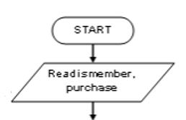
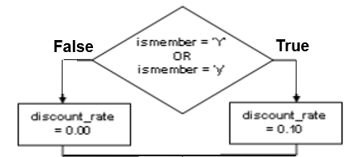
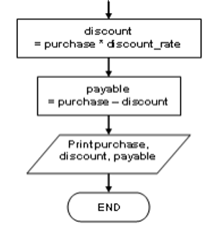
Nested if - Example
#include<iostream>
using namespace std;
void main() {
char ismember;
double purchase, payable, discount_rate;
cout<< “Are you member(Y/N) ? ”;
cin >> ismember;
cout << “Enter purchase: ”;
cin >> purchase;
if (ismember == ‘Y’)
discount_rate = 0.1;
else
discount_rate = 0;
discount = purchase * discount_rate;
payable = purchase – discount;
cout << purchase, discount, payable;
}

Slide 21
Nested if - Example
TAR Computers gives discount to customers (members and non-members) when they are buying computer hardware based on the following table:
Write a C++ program that calculates and display amount payable by the customer after applying the discount given. Draw a flowchart for the program.
Customer Type | Amount Purchase | Discount Given
Member | >= RM500.00 | 20%
 | < RM500.00 | 10%
Non-member | >= RM500.00 | 10%
 | < RM500.00 | No discount

Slide 22
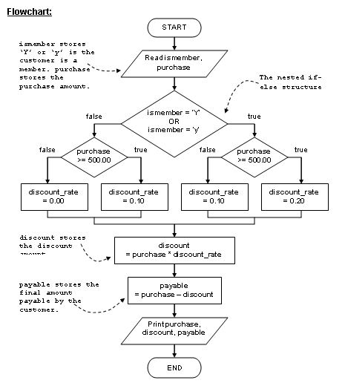

Nested if - Example
Try out the program yourself

Slide 23
Multiple Selection
Multiple selection occurs when there are more than 2 alternative that a single if-else statement can cater for.
Two commands used for multiple selection structure:
  else-if statement
  switch statement

Slide 24
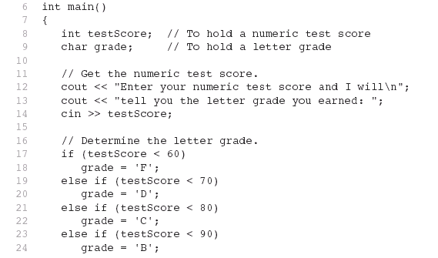
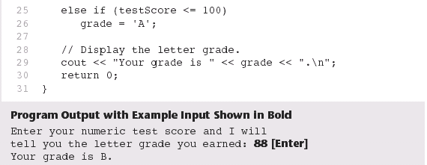
Multiple Selection – else if
Syntax:
if (condition 1)
statement 1;
else if (condition 2)
statement 2;
…
else if (condition n)
statement n;
else
statement default;

Slide 25
Multiple Selection – else if
- Example
Write an else-if statement to test if an integer is positive, negative or zero.
if (integer > 0)
cout<< integer << “ is positive\n";
else if (integer < 0)
cout<< integer << “ is negative\n";
else
cout<< integer << “ is zero\n";
Flowchart
C++ statements
false
true
integer
> 0
false
integer
< 0
true
Print integer
“is positive”
Print integer
“is zero”
Print integer
“is negative”

Slide 26
Multiple Selection – else if
Method 1:
  if (integer > 0)
  cout<< integer << “ is positive\n";
  else if (integer < 0)
  cout<< integer << “ is negative\n";
  else
  cout<< integer << “ is zero\n";
Method 2:
if (integer > 0)
cout<< integer << “ is positive\n";
  if (integer < 0)
  cout<< integer << “ is negative\n";
  if (integer == 0)
  cout<< integer << “ is zero\n";
More efficient! Lesser checking when certain conditions are true and thus save CPU processing time and program can run faster.

Slide 27
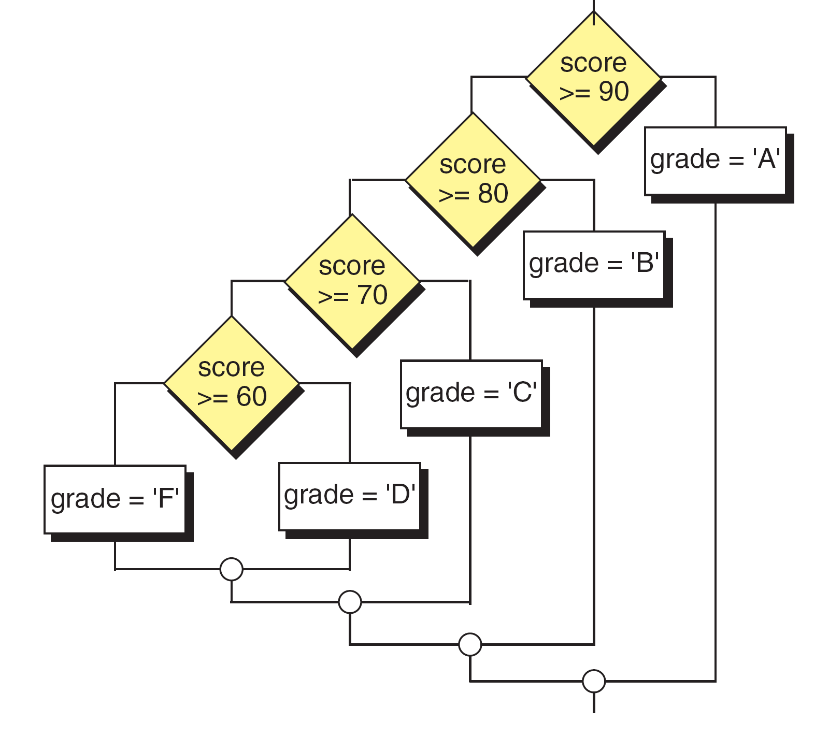
Multiple Selection – else if
- Exercise
Write a C++ program that reads a test score, calculates the letter grade based on the table below, and prints it.
Test Score | Grade
90 – 100 | A
80 – 89 | B
70 – 79 | C
60 – 69 | D
Below 60 | F
Notes:
#include <stdio.h>
int main()
{
int score;
char grade;
printf("Enter test score (0-100): ");
scanf("%d", &score);
if (score >= 90)
grade = 'A';
else if (score >= 80)
grade = 'B';
else if (score >= 70)
grade = 'C';
else if (score >= 60)
grade = 'D';
else
grade = 'F';
printf("The grade is: %c\n", grade);
return 0;
}

Slide 28
Multiple Selection – else if
- Exercise
C++ program:
Notes:
#include <stdio.h>
int main()
{
int score;
char grade;
printf("Enter test score (0-100): ");
scanf("%d", &score);
if (score >= 90)
grade = 'A';
else if (score >= 80)
grade = 'B';
else if (score >= 70)
grade = 'C';
else if (score >= 60)
grade = 'D';
else
grade = 'F';
printf("The grade is: %c\n", grade);
return 0;
}

Slide 29
Multiple Selection – switch
Syntax :
switch (expression)
{
  case label 1
    Statement 1;
    break;
  case label 2
    Statement 2;
    break;
  …
  default
    Statement default;
}
expression type is int or char only
The value of expression is compared against label1 through labeln.
If expression matches value labeln, program branches to the statement following labeln
If no matching value is found, the program branches to the statement after default
break is used to exit the switch statement
default is optional

Slide 30
Multiple Selection - switch
Example:
switch (letter)
{
case 'A':
cout << "Argentina";
break;
case 'B':
cout << "Brazil";
break;
case 'C':
cout << "China";
break;
default:
cout <<"Unknown letter";
}
This switch statement and this else-if statement generate the same result.
if (letter == 'A')
cout << "Argentina";
else if (letter == 'B')
cout << "Brazil";
else if (letter == 'C')
cout << "China";
else
cout << "Unknown letter";

Slide 31
Multiple Selection - switch
Flowchart:
letter
?
‘A’
‘B’
‘C’
default
Print
“Argentina”
Print
“Brazil”
Print
“China”
Print
“Unknown Letter”
Notes:
#include <stdio.h>
int main()
{
int score;
char grade;
printf("Enter test score (0-100): ");
scanf("%d", &score);
if (score >= 90)
grade = 'A';
else if (score >= 80)
grade = 'B';
else if (score >= 70)
grade = 'C';
else if (score >= 60)
grade = 'D';
else
grade = 'F';
printf("The grade is: %c\n", grade);
return 0;
}

Slide 32
Multiple Selection - Exercise
Write a else-if and switch statement that test a letter grade entered by user:
  If the grade is A, B or C, display the message “Credit passed” and assign 100 to variable award.
  If the grade is D or E, display the message “Passed” and assign 50 to variable award.
  If the grade is F, display the message “Failed” and assign value 0 to variable award.
  Display the message “Invalid grade” if it is other letters.

Slide 33
Multiple Selection - Exercise
else-if:

Slide 34
Multiple Selection - Exercise
switch:

Slide 35
Multiple Selection - Comparison
Multiple Selection:
if (gender == ‘M’)
  cout<<“Male”;
  else if (gender == ‘F’)
  cout<<“Female”;
  else
  cout<<“Others”;
Switch statement:
switch (gender)
{
case ‘M’:
cout<<“Male”;
break;
case ‘F’:
cout<<“Female”;
break;
default:
cout<<“Others”;
}

Slide 36
Multiple Selection - Comparison
Multiple Selection:
if (a == 1)
  b=1;
  else if (a == 2)
  b=3;
  else
  b=5;
Switch statement:
switch (a)
{
case 1:
b=1;
break;
case 2:
b=3;
break;
default:
b=5;
}

Slide 37
Multiple Selection - Comparison
Switch statement:
switch (num)
{
case 1:
a=10;
break;
case 2:
case 8:
a=20;
break;
case 4:
case 5:
case 6:
a=30;
break;
default:
a=40;
}
Multiple Selection:
if (num == 1)
  a = 10;
else if (num == 2 || num ==8)
a = 20;
else if (num >=4 && num <= 6)
a = 30;
else
a = 40;

Slide 38
Multiple Selection - Comparison
switch (class){
case '1': classA += 1;
goodClass += 1;
break;
case '2': goodClass += 1;
break;
case '3':
if (average > 3.0)
classB1 += 1;
else
classB2 += 1;
totalclassB += classB1
+ classB2;
break;
default: poorClass += 1;
}
if (class==’1’)
{
classA += 1;
goodClass += 1;
}
else if (class ==’2’)
goodClass += 1;
else if (class ==’3’)
{
if (average > 3.0)
classB1 += 1;
else
classB2 += 1;
totalclassB += classB1 + classB2;
}
else
poorClass += 1;

Slide 39
Nested Switch
A switch statement is nested within another switch.
switch (a)
{ case 1:
if (b == 10)
cout<<“Yes”;
else if (b == 20)
cout<<“Yes Yes”;
break;
case 2:
if (b == 10)
cout<<“No”;
else if (b == 20)
cout<<“No No”;
break;
}
nested if:
if ( a == 1)
if (b == 10)
cout<<“Yes”;
else if (b == 20)
cout<<“Yes Yes”;
else if (a == 2)
if (b == 10)
cout<<“No”;
else if (b == 20)
cout<<“No No”;

Slide 40
Nested Switch
switch (a)
{ case 1:
switch (b)
{ case 10:
cout<<“Yes”;
break;
case 20:
cout<<“Yes Yes”;
}
break;
case 2:
if (b == 10)
cout<<“No”;
else if (b == 20)
cout <<“No No”;
break;
}
switch (a)
{ case 1:
if (b == 10)
cout<<“Yes”;
else if (b == 20)
cout<<“Yes Yes”;
break;
case 2:
if (b == 10)
cout<<“No”;
else if (b == 20)
cout<<“No No”;
break;
}

Slide 41
Nested Switch - Example
A manufacturer sells machinery parts to its customers. The price of machinery parts for different model of machine is listed below:
Use switch statements to get the price of a particular machinery part based on the model number and part number. Display an error message if the model number or part number is unmatched.
Model No. | Part No. | Price (RM)
100 | 300 | 1500.00
 | 600 | 3000.00
200 | 400 | 2500.00
 | 800 | 4000.00
Notes:
switch (model)
{
case 100:
switch (part)
{
case 300:
price = 1500.00;
break;
case 600:
price = 3000.00;
break;
default:
printf("Invalid part number");
}
break;
case 200:
switch (part)
{
case 400:
price = 2500.00;
break;
case 800:
price = 4000.00;
break;
default:
printf("Invalid part number");
}
break;
default:
printf("Invalid model number");
}

Slide 42
Nested Switch - Example
switch (model) { case 100: switch (part) { case 300: price = 1500.00; break; case 600: price = 3000.00; break; default: cout<<"Invalid part num"; } break;
case 200: switch (part) { case 400: price = 2500.00; break; case 800: price = 4000.00; break; default: cout<<"Invalid part num"; } break; default: cout<<“Invalid model num"; }

Slide 43
Nested Switch - Exercise
Assume that the cost of a product manufactured in year 2016 and year 2019 is 200.50 and 350.30 respectively without considering the product code. The cost for year 2017 or year 2018 is determined by code as shown in the table below.
Write a program that using nested switch to display the tuition fee based on user input of year and code.
Year | Code | Cost(RM)
2016 |  | 200.50
2017 or 2018 | A | 89.00
 | B | 105.90
 | Others | 79.80
2019 |  | 350.30

Slide 44
Nested Switch - Exercise
C++ program:

Slide 45
Summary:
Single Alternative selection:
if (a != 5)
b = 10;
Dual Alternatives selection:
if (a != 5)
b = 10;
else
b = 20;
False
a!=5
True
b = 10
False
a!=5
True
b = 20
b = 10

Slide 46
Summary:
Nested if:
if (a != 5)
b = 10;
else
if (a == 1)
b = 20;
else
b = 30;
a!=5
False
True
False
a=1
True
b = 10
b = 30
b = 20

Slide 47
Summary:
else-if statement:
if (a != 5)
b = 10;
else if (a == 1)
b = 20;
else if (a >= 7)
b = 30;
else
b=40;
False
a!=5
True
False
a=1
True
False
a >= 7
b = 10
True
b = 20
b = 40
b = 30

Slide 48
Summary:
Switch statement:
switch (num)
{
case 1:
a = 10;
break;
case 2:
a = 20;
break;
default:
a=30;
}
num=?
1
2
default
a = 10
a = 20
a = 30

Slide 49
Summary:
Nested-switch statement:
switch (num)
{
case 1: a = 10;
break;
case 2: switch(digit)
{
case 11:
a = 20;
break;
case 33:
a = 40;
}
break;
default:
a=30;
}
num=?
1
2
default
a = 10
digit=?
a = 30
11
33
a = 20
a = 40

